Slide 1
Smart Pantry
Rishabh Misra

Slide 2

Technological Motivation - Internet of Things
Increased relevance of Internet of Things
Pantries left behind in advancement

Slide 3
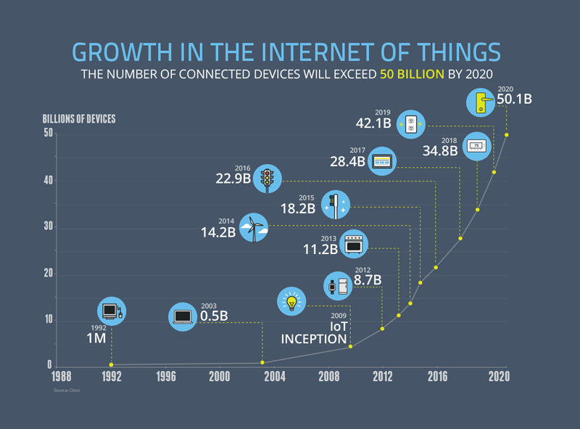

Slide 4
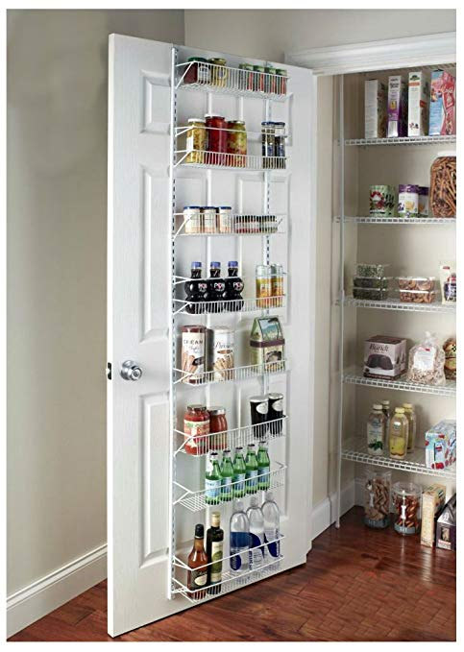
Personal Motivation
I often don’t remember what runs out in pantry, or even at times what is in the pantry
Going to college - need to manage pantry

Slide 5

What is needed
Easy way for people to track food items within pantries
Accessibility in order to improve user efficiency
Internet connectivity w/ other IoT devices

Slide 6


Proposal
I propose creating a visual processing system that uses a camera to observe what is in a pantry at certain times, noting the specific products and the prevalence of each.
How I’m going to solve this problem

Slide 7
System Overview
Barcode Detection
Camera Input
Lookup
Output
Logo Detection
Detection
Tracking

Slide 8

Winter Goal
Achieve simultaneous barcode and logo detection & classification in pre-existing photos
Detection to output stage of system overview

Slide 9
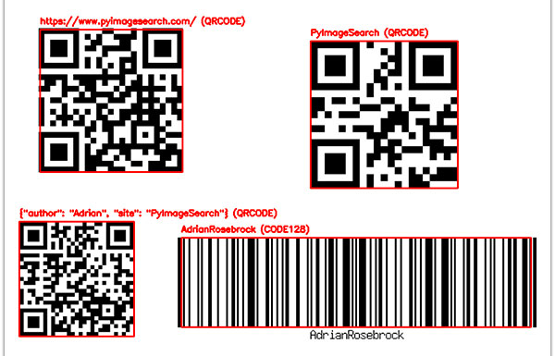
Barcode Detection
Conducted using ‘pyzbar’ library
Detects bounding box coordinates
Decodes using utf-8
Plots using OpenCV

Slide 10
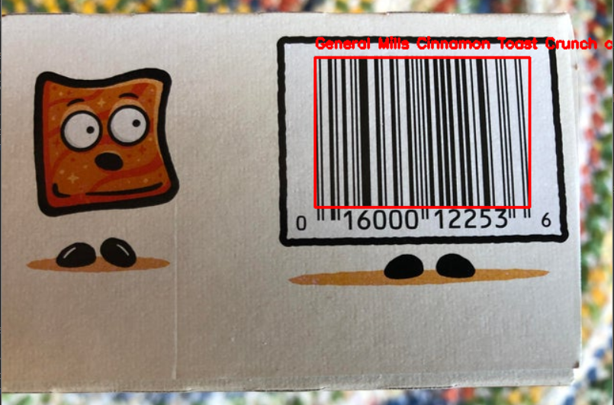
Barcode Detection Example

Slide 11

Logo Detection
Used Google Cloud Vision API
Struggled with authentication issues
Google logo detection client

Slide 12
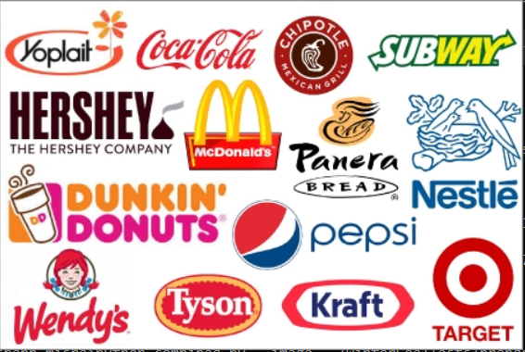
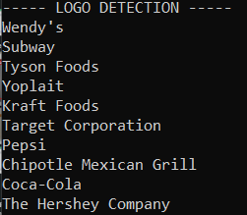
Logo Detection Example

Slide 13

Lookup System
Primarily focused on barcode lookup
Difficult to find logo detection library
UPC Database API
Returns name+description of object found

Slide 14
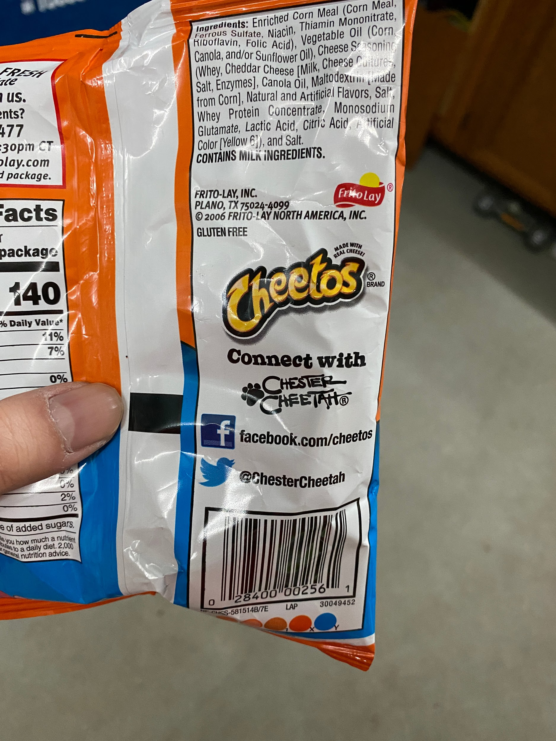
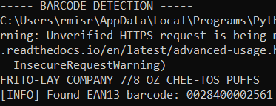
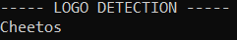
Putting Everything Together

Slide 15
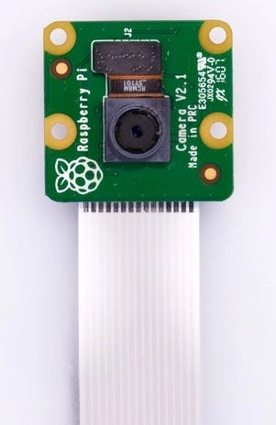
Camera Input
Raspberry Pi Camera Module V2 on Raspberry Pi 4
Not fully set up (lack of hardware)
Have program to periodically take pictures

Slide 16
Future Steps/Goals
Finalizing camera setup
Tracking
Seeing what does/doesn’t remain in consecutive snaps
Creation of user interface

Slide 17
Thank you!
Questions?

